Slide 1
Music player

Slide 2
Hello!
I am kidist mamaye
I am a BahirDar University
software engineering student.
And I am here to present my mobile app.

Slide 3
1.Introduction
Let’s start with the detail

Slide 4
Music can change
the world because
it can change
people.

Slide 5
This is a slide title
introduction
screens
features

Slide 6


Big concept
Listning music and ejoy the world

Slide 7
Introduction
This app is a music player application where you can listen music every where
it will you help you to enjoy and relief your stress by listening a song

Slide 8
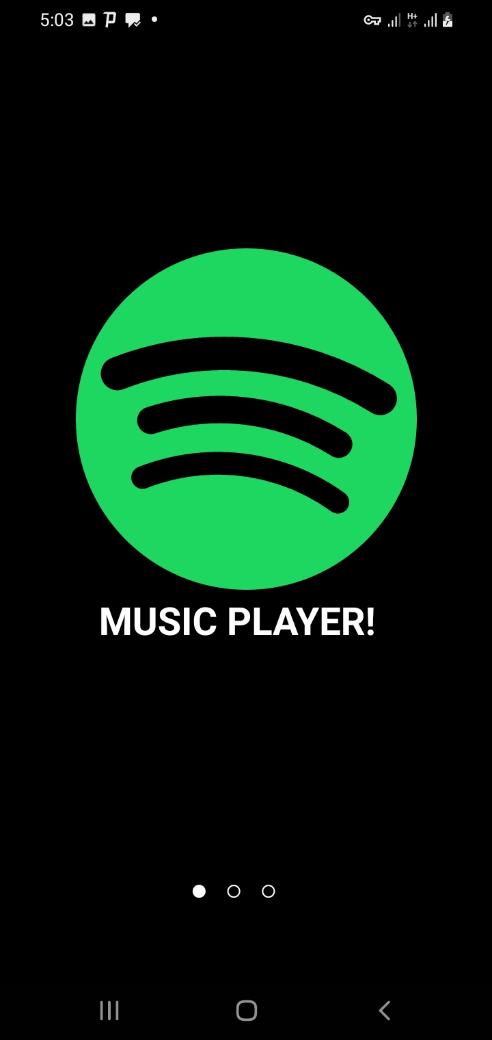
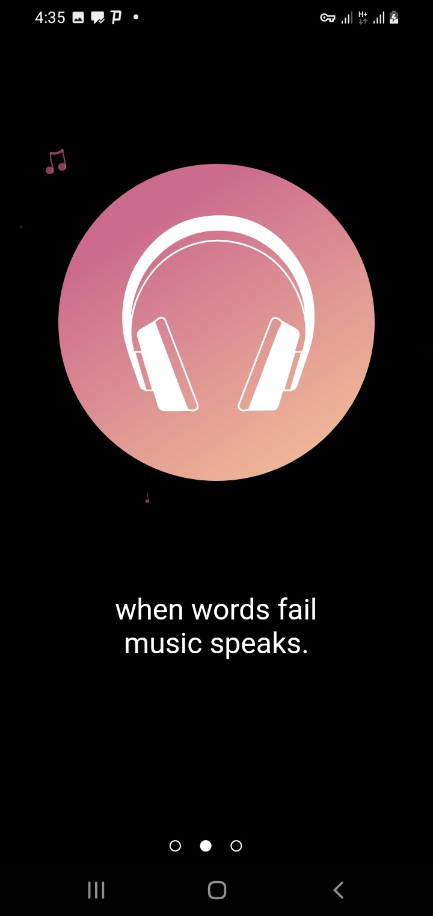
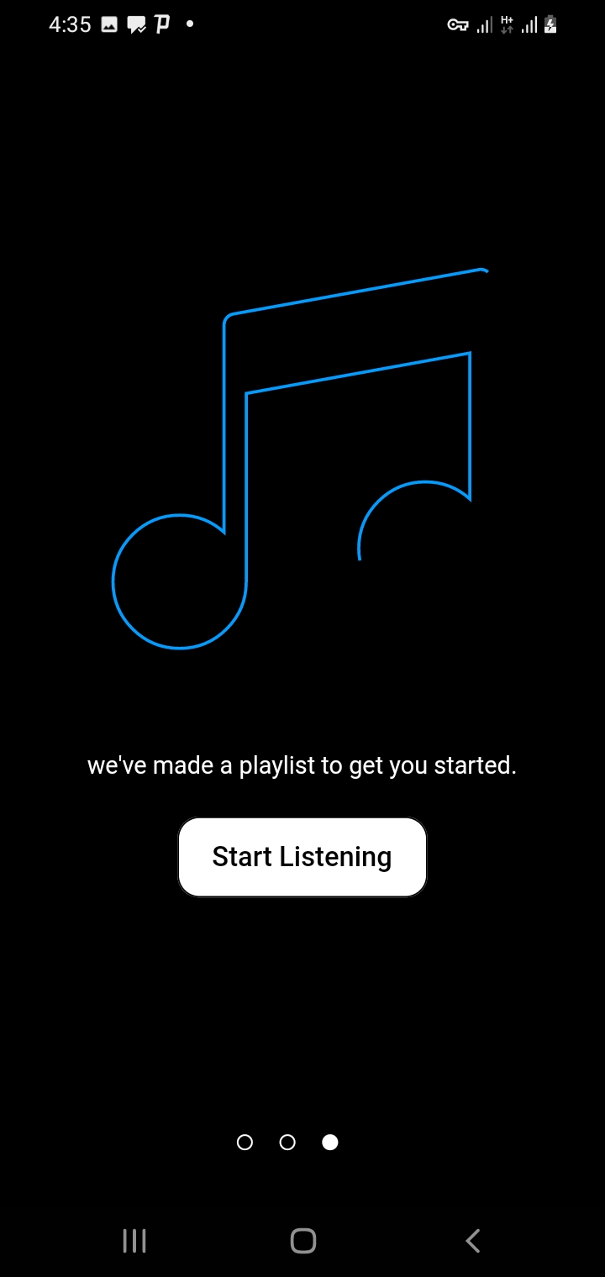
The first pages to slied

Slide 9
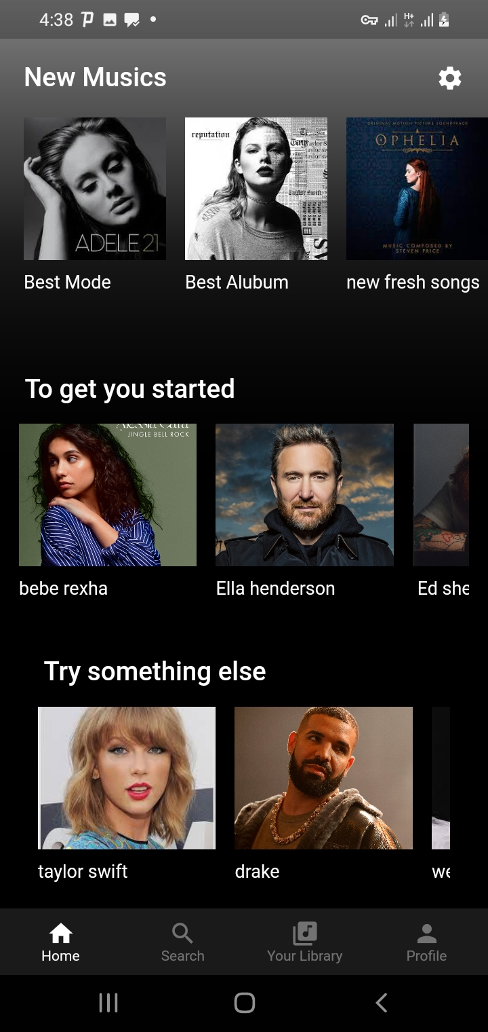
Home Page
This shows the home page
Of my app .

Slide 10
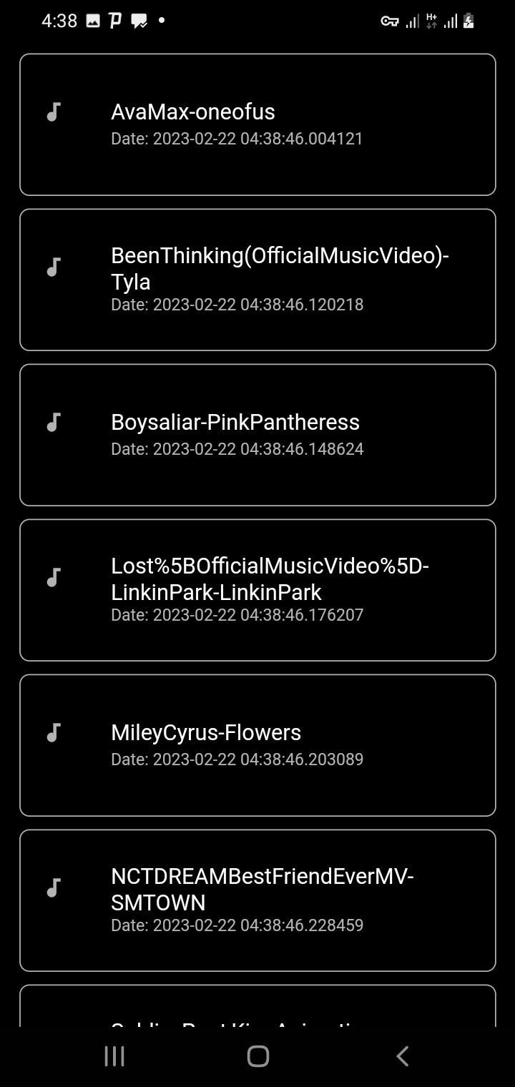
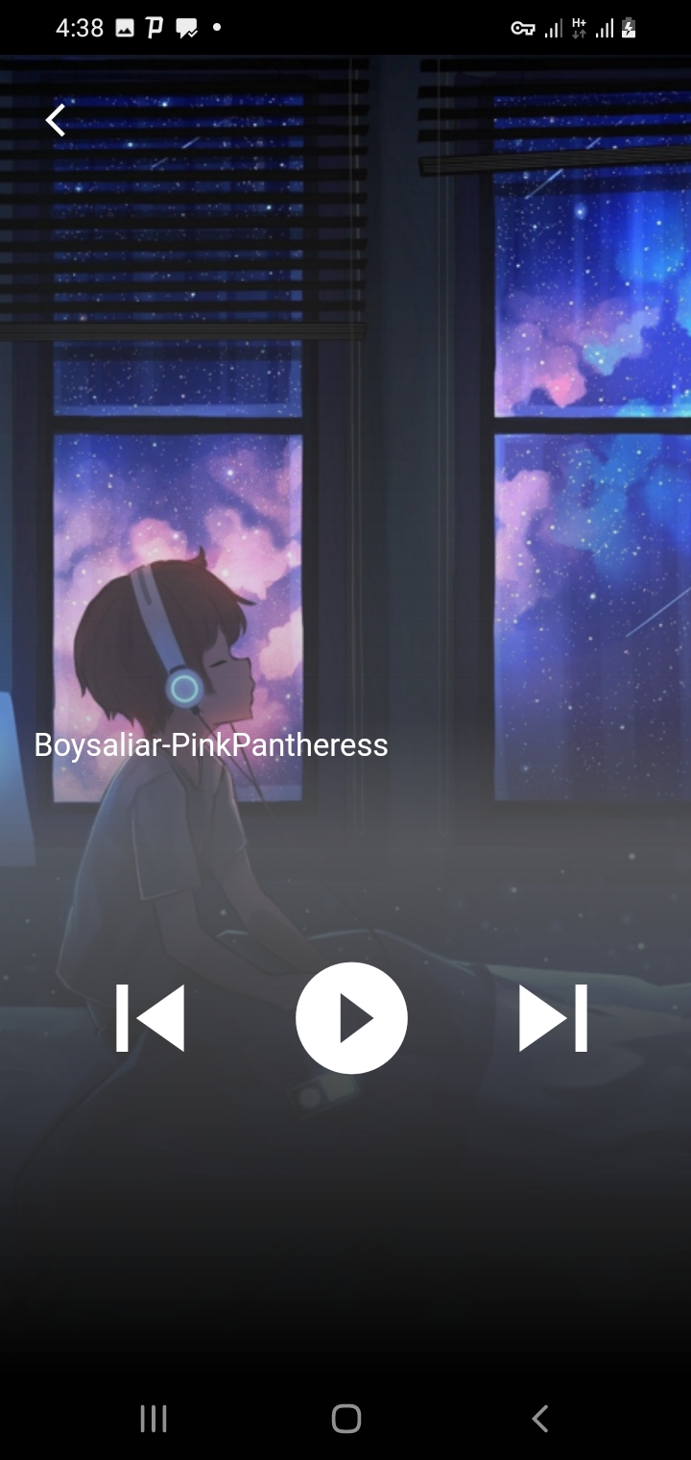
The list and play page
Shows lists of songs and can choose and go to play page

Slide 11
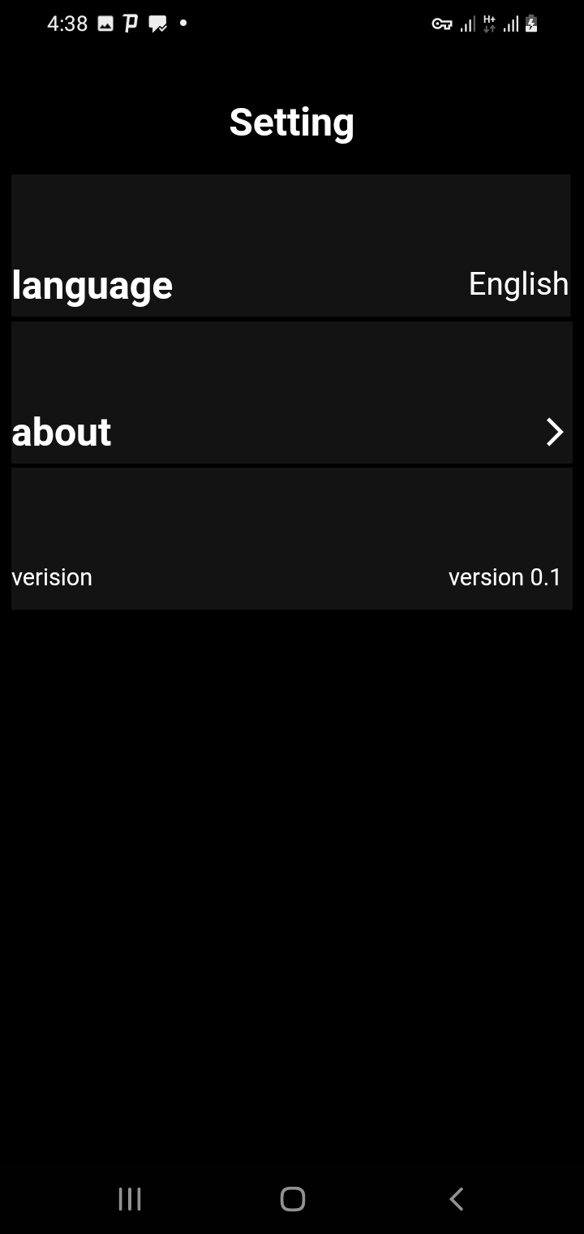
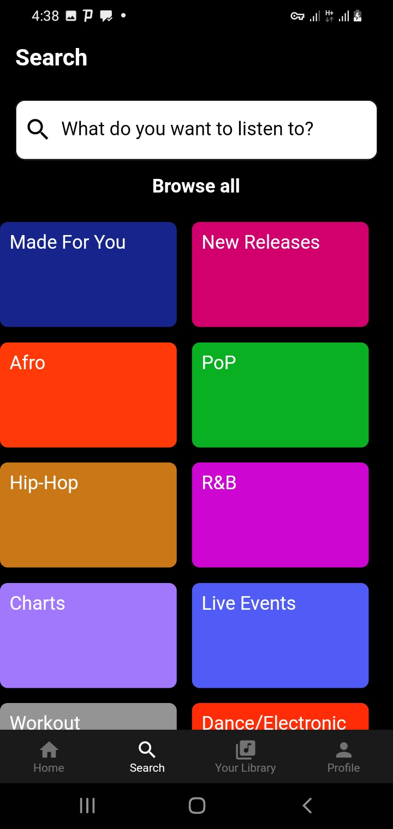
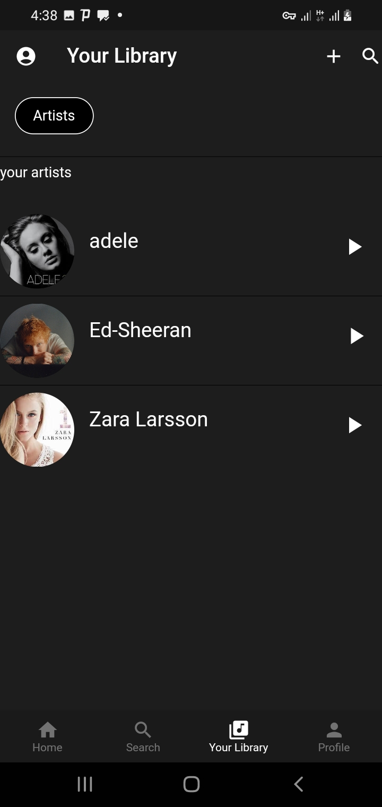

Slide 12

features
Can pause and play our song

Slide 13
Thanks!
Any questions?
You can find me at
kidistmamaye2002@gmail.com

